Slide 1

What are they doing?
A plugin to detect user behavior on your web site

Slide 2
In order to provide better user experience we have to know how our customer is using
our site. But How can we know?
Standing behind him/her to see what are they doing?

Slide 3
NO

Slide 4
We can use a plugin to detect and record all user action on page and save these data into a database. And then, system can tell you what’s the user experience of our customer.

Slide 5
How it works
Database
Query
Query
Processor
Report
Detector
Listener
BI Analysis

Slide 6
What’s detector?
Detector is a JS file. Once you load this JS file in our site, all user action in the site will be posted (Using Json format) to listener to be saved.
The action can be follow:
Focusing on an element
Lost focusing from an element
Typing in an element
Navigating to another page by clicking an element

Slide 7
What’s listener?
Listener is just a simple page or web service to receive post Json string and save it into database.

Slide 8
What customer can do with it?
Through this plugin site admin can see following info on real time:
How many visitors on the site;
Which page they stay at;
The navigation path of each visitor on the site;
What they have done on the site;

Slide 9
What we can do with it?
We can reproduce all user actions on our site.
We can see how long each page that user stays at.
We can know usual user though which way go to certain page.
Anything you need to know about user experience.

Slide 10
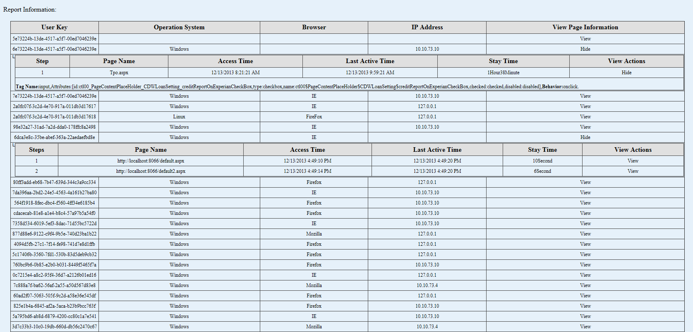
Demo our prototype

Slide 11
Thanks
More date more possibility!

